Slide 1

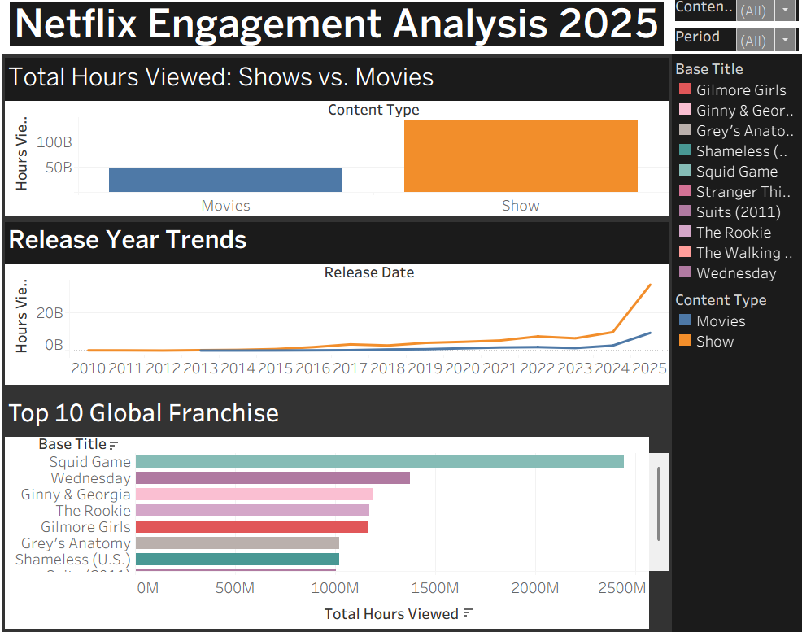
Netflix Engagement Analysis: 2025 Global Trends
Andrii Semeniuk
Data Analytical Tools L7 Dip. in Data Analytics - Sept 2025
Introduction
Results
Conclusions
In this project, I analyzed Netflix’s viewership data from two reports covering the full year of 2025 (H1 and H2).
My goal was to see how different types of content, like Movies and TV Shows, compare in terms of total watch time.
The Big Picture: TV Shows are clearly the winners, bringing in over 140 billion hours of views.
Top Franchises: After cleaning the names, Squid Game became the #1 franchise, showing that people love following a brand across multiple seasons.
Trends: The trend line shows that while new releases get spikes, older "library" shows still get steady views every year.
Strategy: Netflix should keep focusing on TV series because they keep people watching much longer than single movies.
Brand Power: Investing in spin-offs for top franchises is a safe bet since these titles already have a massive audience.
Old Content: We shouldn't ignore older shows; they provide great long-term value for the platform.
Methods
Data Prep: I merged two large Excel files and used an IFERROR formula with wildcards to clean the titles.
Base Titles: This allowed me to group all seasons of a show into one "Base Title" so the data for franchises like Squid Game would be more accurate
Tableau: I built an interactive dashboard to visualize the trends and used the "Use as Filter" feature to make it easier to explore the data.
Reference List:
Netflix (2025) What We Watched: A Netflix Engagement Report. Available at:
https://about.netflix.com/en/news/what-we-watched-the-first-half-of-2025
https://about.netflix.com/en/news/what-we-watched-the-second-half-of-2025
Tableau Desktop (2025) Version 2024.2. Seattle, WA: Tableau Software, LLC.
Fig. 1 Caption size 24pt Arial and exactly 34pt space between lines
References
Reference text size 15pt Arial and exactly 22pt space between lines
Our Dedication.Your Journey.
www.cct.ie

